Slide 1

Human Resources Updates
December 2019

Slide 2






About Us
Vision, Mission & Core Values
Albemarle County Public Schools (ACPS) serve 13,972 students from preschool through
grade 12. Our school division includes :
VISION
15 elementary schools (PK-5)
6 middle schools, including 1 charter middle school (6-8)
4 high schools, including 1 charter high school (9-12)
  3 science and technology academies (9-12)
Working together as a team to provide
excellent human resources services
1 high school center specializing in project
based learning (9-12)
1 education center specializing in short-term
intervention (6-12)
1 regional technical education center (9-12)
1 regional center serving special education
students (K-12)
1 regional center serving students with
emotional disabilities (K-12)
MISSION
Working as strategic partners supporting organizational goals and helping employees with all phases of their Albemarle County careers
We employ:
1,344 Teachers (includes school counselors and
other related service providers)
1,144 Classified Staff
52 Principals and Assistant/Associate Principals
83 Other Administrators
2,620 Total Employees (dual jobs only counted
once)
CORE VALUES
Treat everyone with dignity, empathy and respect
Take a purposeful, thoughtful approach to our work
Provide clear, consistent communication

Slide 3

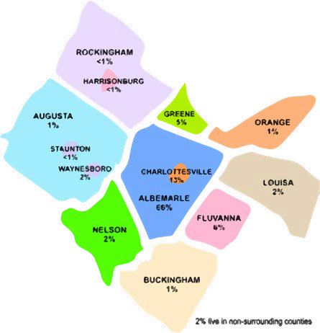
2,620
employees
27
average
years of service
Employees at a Glance
26%
where our employees live
Total
S
taff
male
74%
45
average age
female
81% White (non-Hispanic) 12% Black or African American 3% Hispanic or Latino
2% Asian
2% Two or More Races
<1% American Indian
or Alaskan Native
<1% Native Hawaiian
or Pacific Islander
357
new hires
(July 1 - September 30)
New Hires
115
Male - 47%
Female - 53%
Minority - 23%

Slide 4
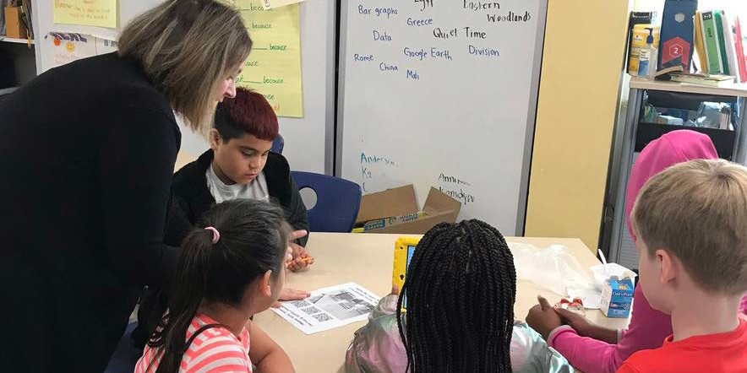
1,344
teachers
Recruitment and Selection
The top priority of the Human Resources Department is to recruit, select, develop, and retain the highest quality employees. For the 2019-2020 school year, the Albemarle County Public School Division hired 190 teachers. Fourteen percent of the total teaching staff for 2019- 2020 are new hires.
Teacher screening interviews are a vital part of our recruitment and hiring process. School administrators consistently report that screening interview results are a much-valued resource, allowing them to prioritize their time on the most promising candidates. This year 770 teacher screening interviews were completed. To help mitigate the impact of implicit bias, all interviews were completed via telephone this year. For the upcoming school year, the Human Resources Department will be incorporating an initial computer-based screening assessment, along with the screening interview. This process will assist in providing more objective candidate ratings, as well as generate additional summary information regarding the specific skill sets of candidates.
23%
190
new hires
male
77%
female
TEACHERS
42
average age
90% White (Non-Hispanic)
Of the 190 teachers hired:
5% Black or
32 (17%) are minorities
164 (86%) are full-time; 26 (14%) are part-time
138 (73%) have previous teaching experience
77 (41%) have 0-3 years of teaching experience
103 (54%) have five or more years of teaching experience
111 (58%) have previously taught in Virginia
52 (27%) are starting their teaching careers in ACPS
136 (72%) have at least a Master’s degree
149 (78%) are female; 41 (22%) are male
79 (42%) were hired for the elementary level
102 (54%) were hired for the middle and high school (secondary) levels
9 (5%) were hired in the Instruction, Special Services, and Technology departments
African American
3% Hispanic or Latino
2%
Two or More Races
1% Asian
8.55
<1% American Indian
or Alaskan Native
<1% Native Hawaiian
or Pacific Islander
average years of service

Slide 5

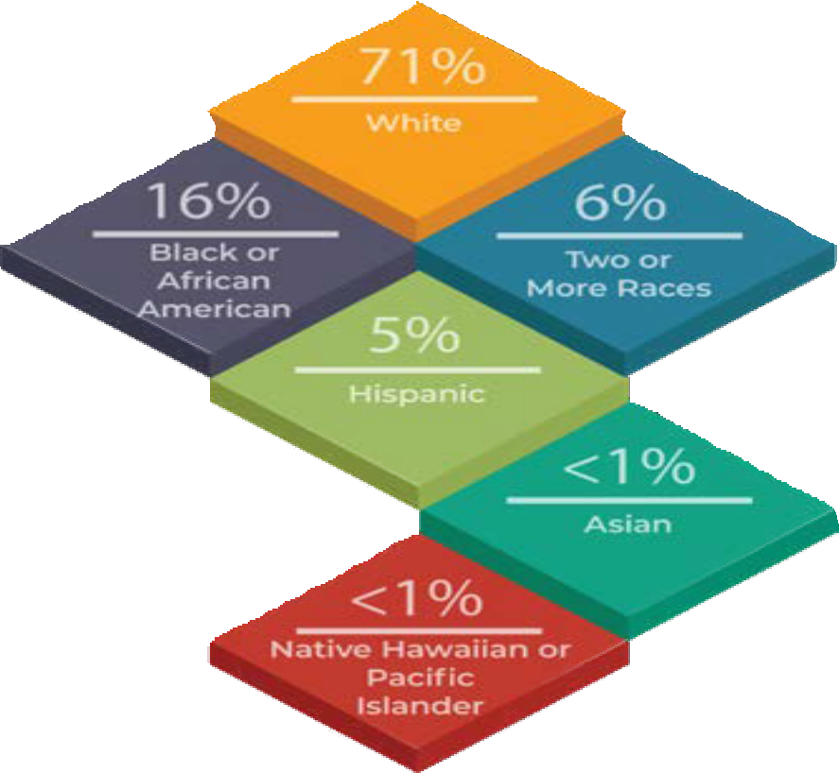
1,144
Recruitment and Selection
Classified employees include all non-teacher and non-administrative positions in the School Division. Examples include all non‐administrative employees in Transportation, Building Services, Child Nutrition, and Extended Day Programs. Office Associates, School Nurses, and Teaching Assistants (TAs) are also considered classified employees.
classified staff
28%
159
new hires
male
Diversity in Recruiting and Staffing
While most teacher and administrative hiring occurs July 1 through September 30, classified employees are hired throughout the school year.
In 2019, during the July- September period, 159 new classified employees were hired.
72%
female
CLASSIFIED STAFF
48
72% White (Non-Hispanic)
20% Black or
African American
4% Hispanic or Latino 3% Asian
average age
2% Two or More Races
<1% American Indian
7
or Alaskan Native
<1% Native Hawaiian
or Pacific Islander
average years of service

Slide 6
Exit Surveys
Survey data was collected for employees leaving the School Division between October 1, 2018
and September 30, 2019.
personal: moving from area (13.11%),
personal: return to school/student teaching (6.56%)
retirement (6.56%)
pay/benefits: dissatisfaction with pay (5.74%)
people-related issue: quality of supervision/management (5.74%
personal: family responsibilities (5.74%)
change job/career: promotion within the organization (5.74%)
The percentage of all employees exiting with 0-5 years of service was 72%. The following is a
breakdown of the classified/administrative employees who left the School Division: 3%
administrators, 8% office associates, 47% support staff, and 42% teaching assistants.

Slide 7




Compensation Broadbanding
Program
Goals
Facilitating career development
Greater emphasis on succession planning
Supporting strong team- building

Slide 8
Compensation Broadbanding
Program
Pay Band | Former Pay Grade | 2019-20 Minimum | 2019-20 Maximum
I | 20-25 | $65,654 | $150,041
II | 26-28 | $98,629 | $185,358

Slide 9
Compensation Broadbanding
Program
 | Before Broadband SY 2012-15 | After Broadband SY 2017-20
Inter-broadband changes | 20 | 72

Slide 10








HR Focus…Going Forward
Teaching and Classified Staff diversity, inclusion and engagement
Substitute teacher initiatives
Electronic time and attendance system
Increasing minimum starting salary
Recruiting & Hiring Developing Retaining

