Slide 1
ACPS School Board Informational Session
Red Hill Elementary School
Phase 2 – Renovations and Additions
October 10, 2019

Slide 2
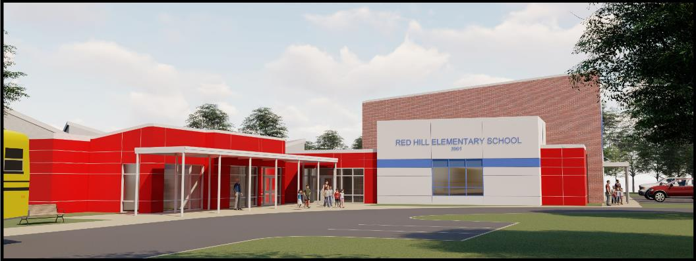
Today’s Agenda:
Project Summary
Site Plan
Building Plans
Exterior Character
Statement of Probable Cost
Project Schedule

Slide 3
Project Summary:
Gym addition with support spaces
Interior renovations to toilets, hallways, support spaces, kitchen and serving line
Repurposing existing gym and media center
Site improvements including outdoor learning space enhancements and modifications to septic field
Alternate for HVAC improvements for the cafeteria
Alternate for Stage addition

Slide 4
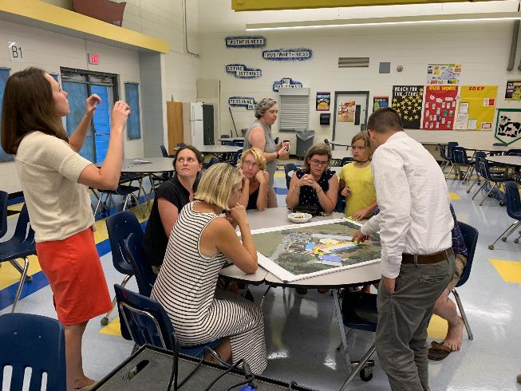
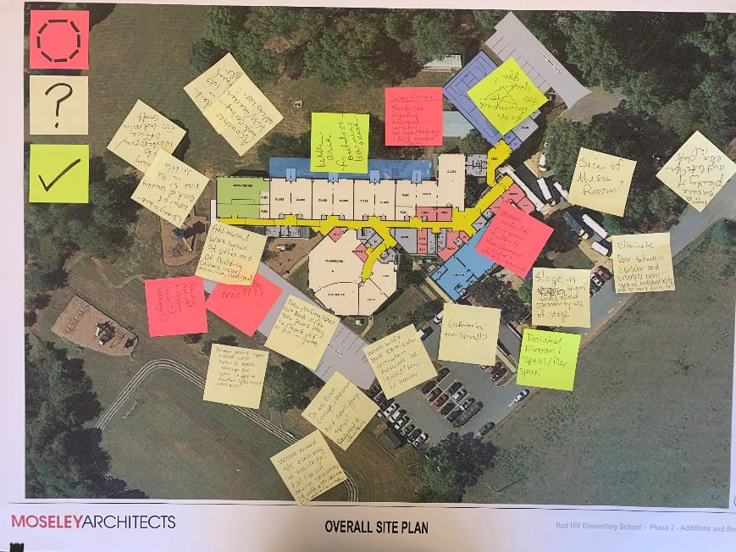
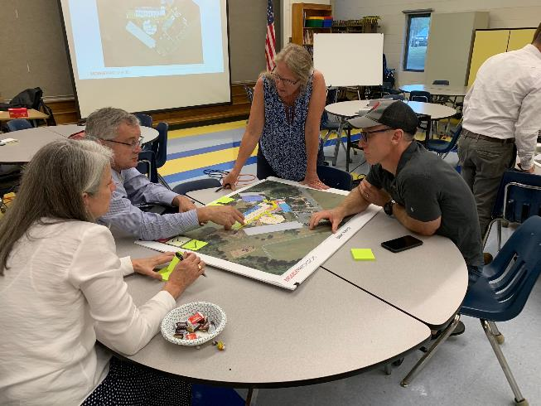
Stakeholder and Community Input:
Staff Meeting – September 5, 2019
PTO Meeting – September 10, 2019

Slide 5
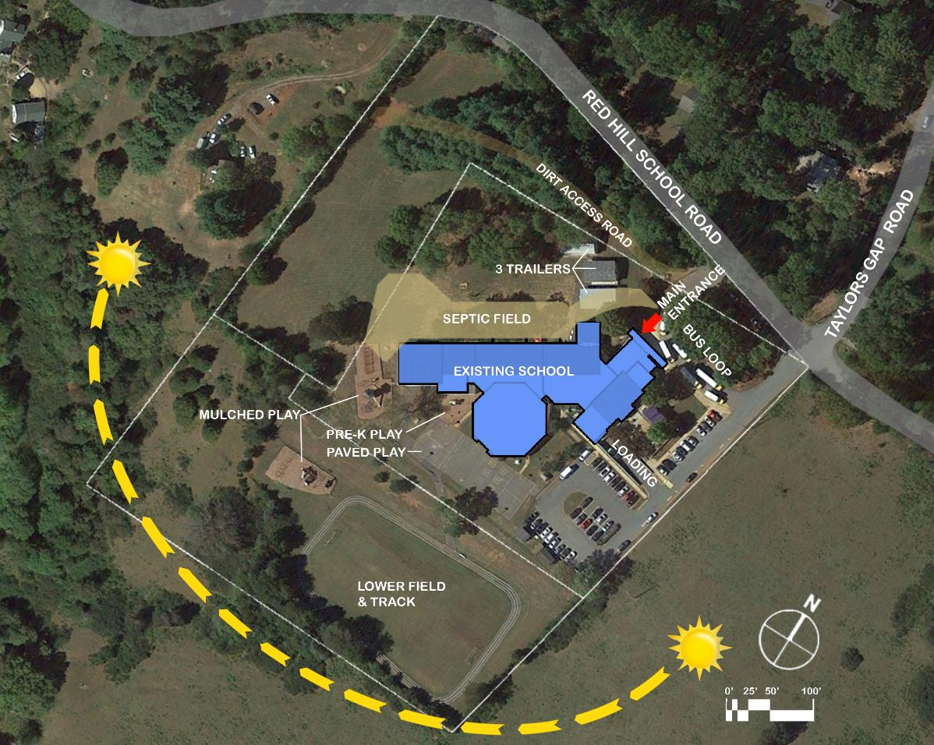
Existing Site Plan:
Site Issues and Constraints
Additional parking needed
Three mobile classrooms
Separate cars from the play areas
Extents of existing septic field may be impacted by addition
Existing Site Plan

Slide 6
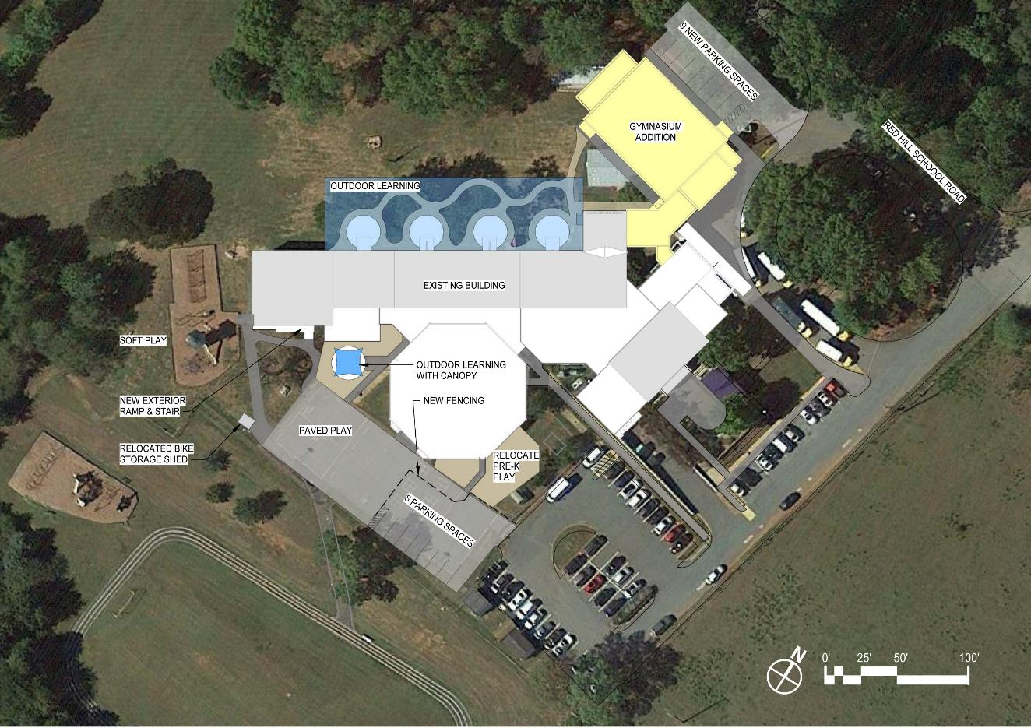
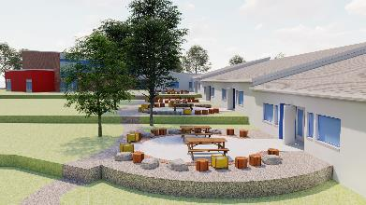
Proposed Site Plan:
Outdoor Learning
Site Modifications
Additional 17 parking spaces
Better access for after hours use of gym
New fencing separates cars from the children play areas
Relocated pre-K play for better adjacency and access by classes
Relocated bike shed for safe access to the paved play area
Improved classroom outdoor learning areas
Northern section of septic field impacted by addition
New Site Plan

Slide 7
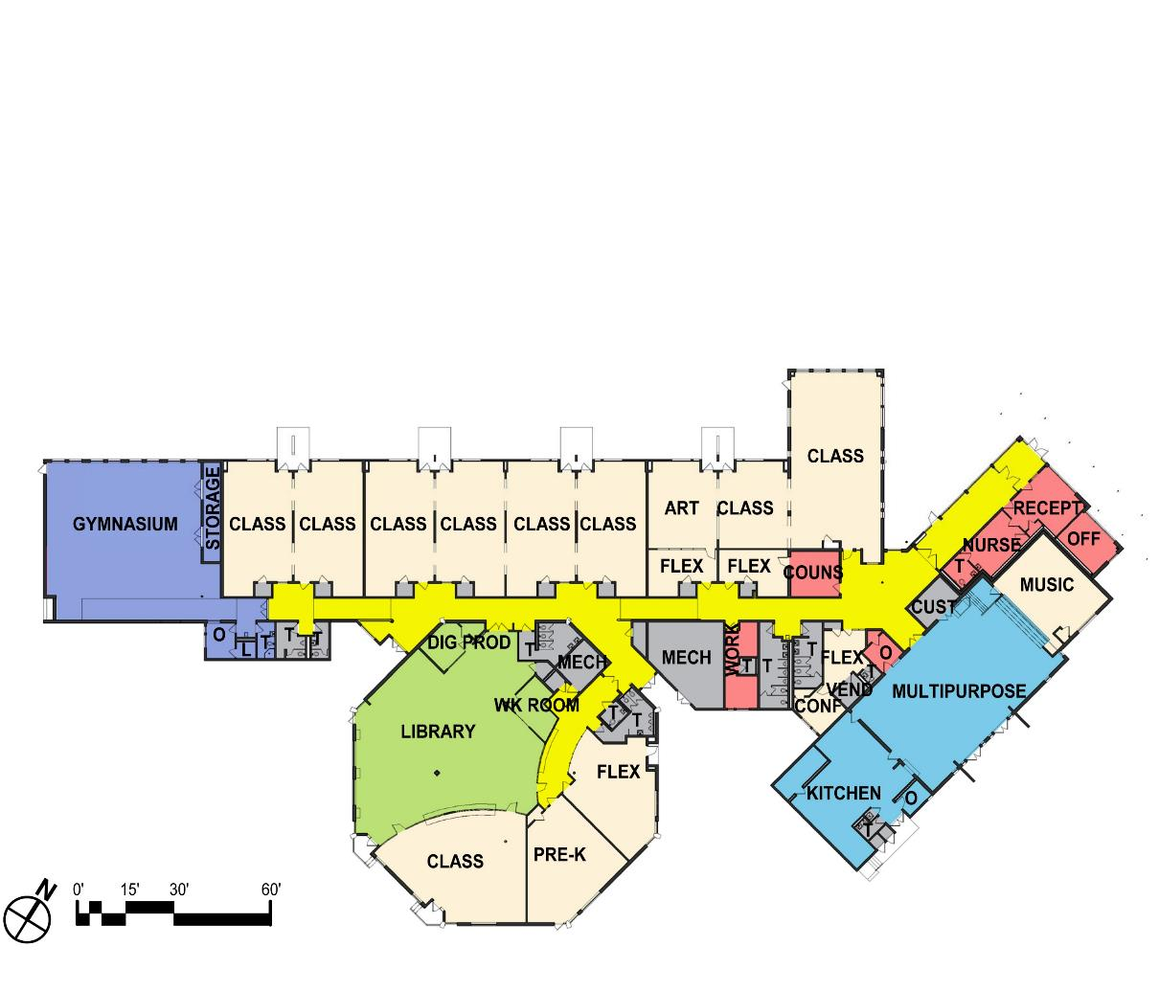
Building Plans:
Existing Overall Floor Plan
Newly updated classrooms, Library and Administration addition in 2016
Ten Classrooms within building
Counselor, Bookroom, Classroom, small group flex space and Itinerant spaces in 3 portable classrooms on site
Small Gym with non ADA compliant ramp
Two ADA compliant toilet rooms – remainder non-compliant

Slide 8
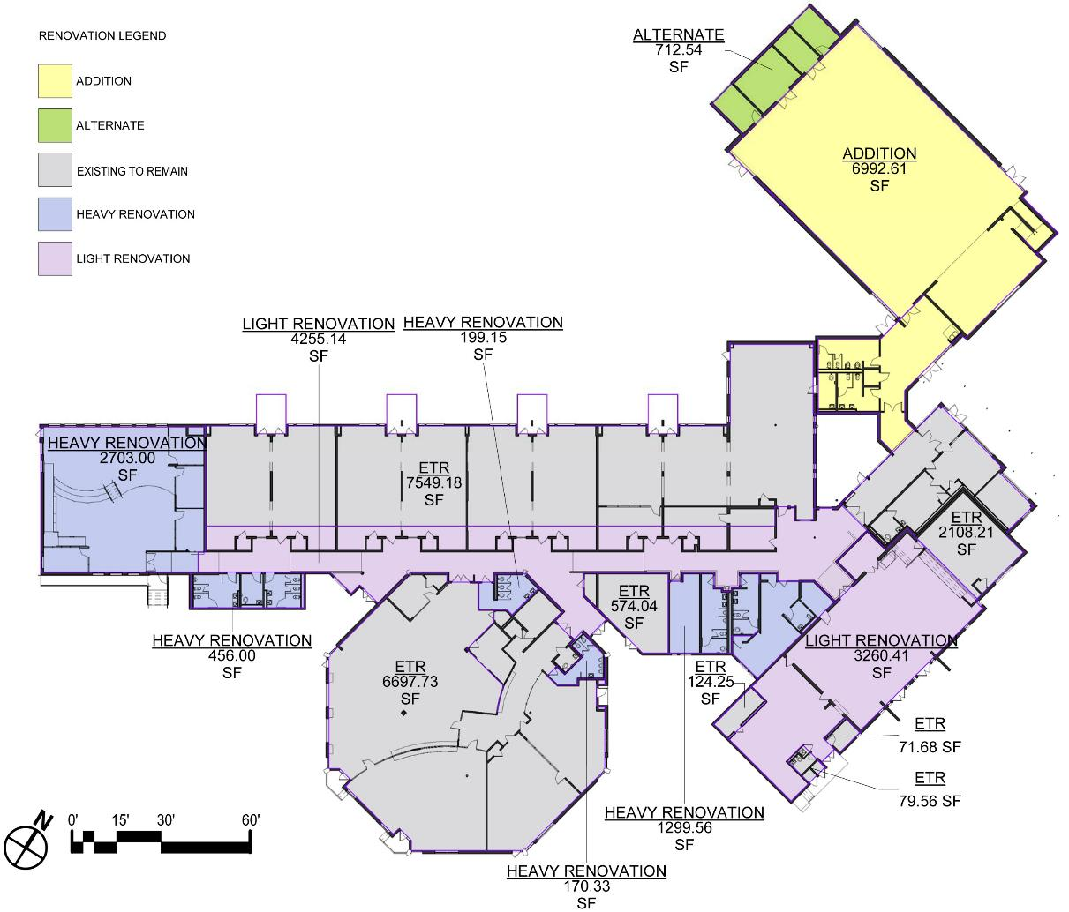
Building Plans:
Scope of Renovations
New Construction Square Footage: 6,993 SF
Major Renovation Square Footage: 4,831 SF
Minor Renovation Square Footage: 7,515 SF
Existing to Remain Square Footage: 16,928 SF
Add Alternate Square Footage: 712 SF
Scoping Plan

Slide 9
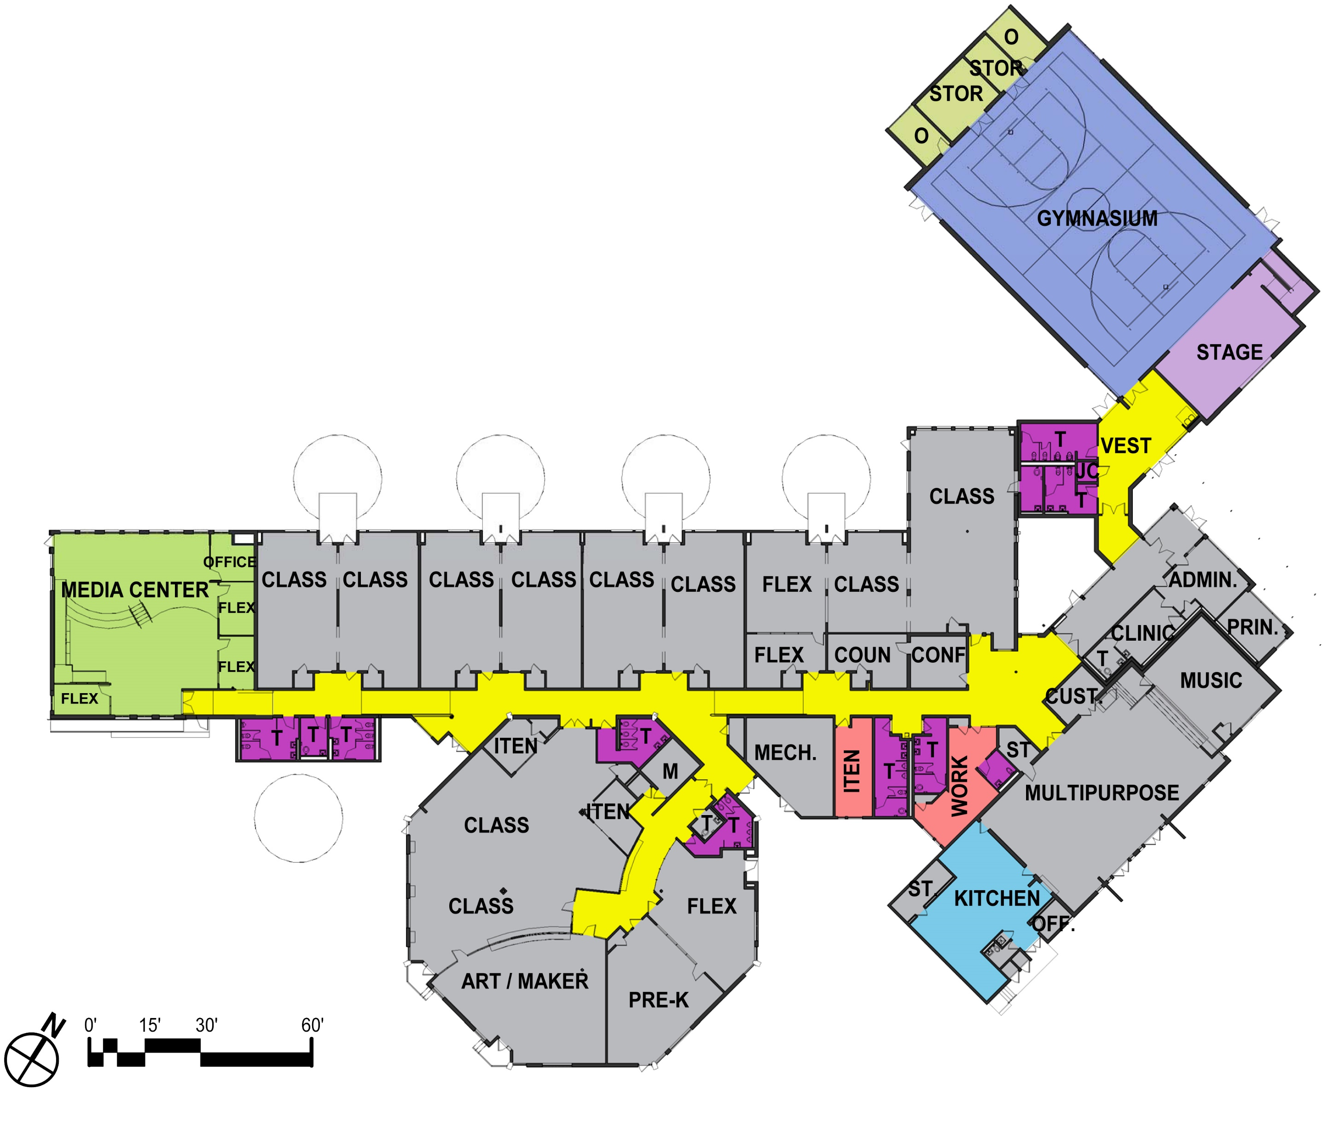
Building Plans:
New Overall Floor Plan
Eleven Classrooms within building
Large Gym addition located at the front/public side of building
Improvements to toilet room accessibility
Expanded Professional space
Existing Gym converted to Media Center
Library converted to two classrooms and itinerant space
Multiple Flex and Itinerant spaces throughout the building

Slide 10
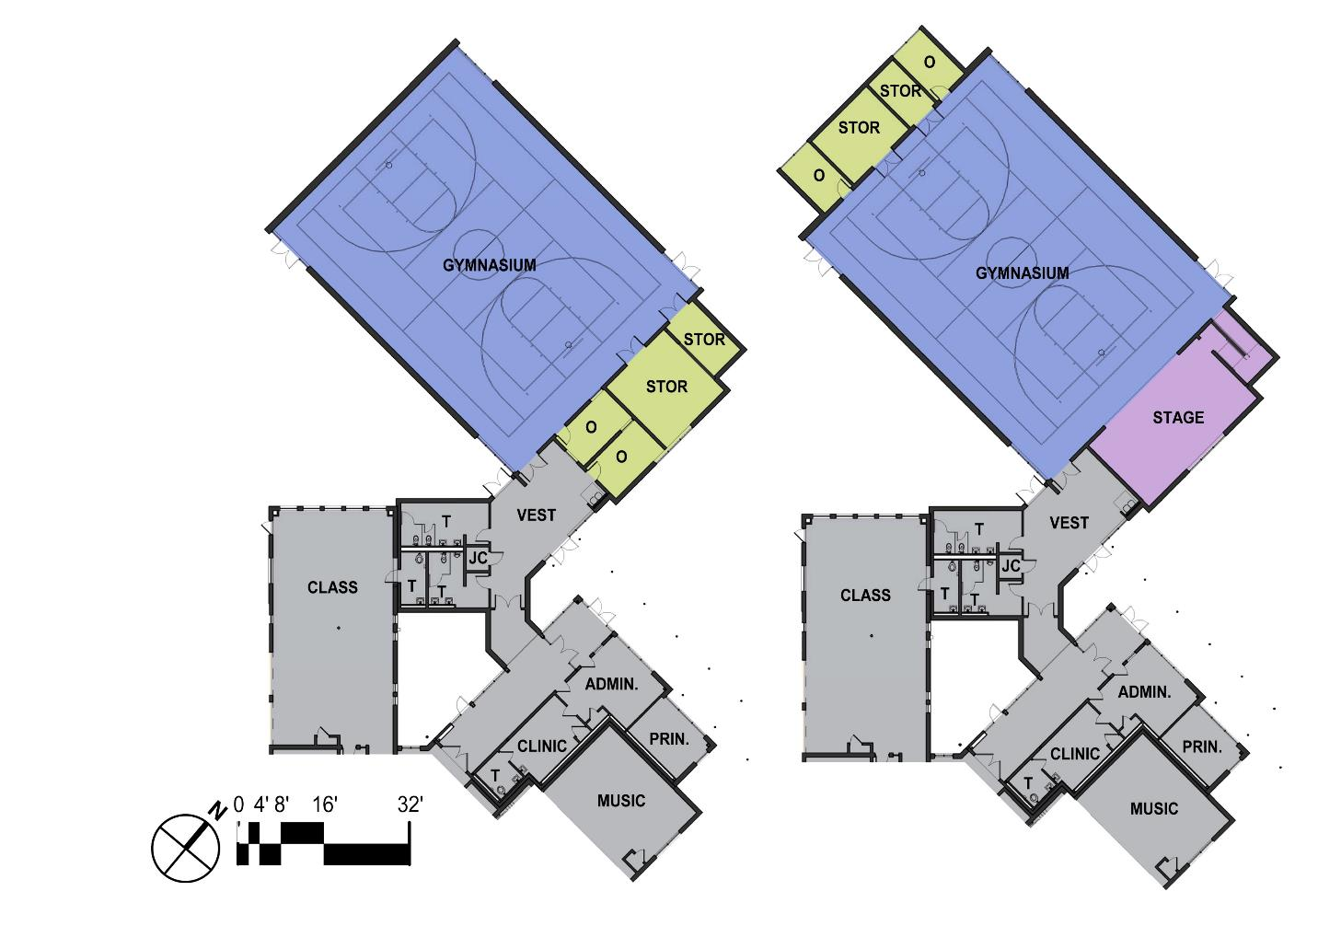
New Addition Plans:
Base Bid Plan
Alternate Plan
Base Bid Plan
Secure connection to existing school
New Gymnasium with Storage and PE office
Additional Office for afterschool activities and associated storage space
Two new toilet rooms able to be secured for after hours use of gym
One new toilet directly adjacent to classroom
Alternate Plan
Storage and office space moved to northwest side of Gym
Stage and Ramp included in Gym space

Slide 11
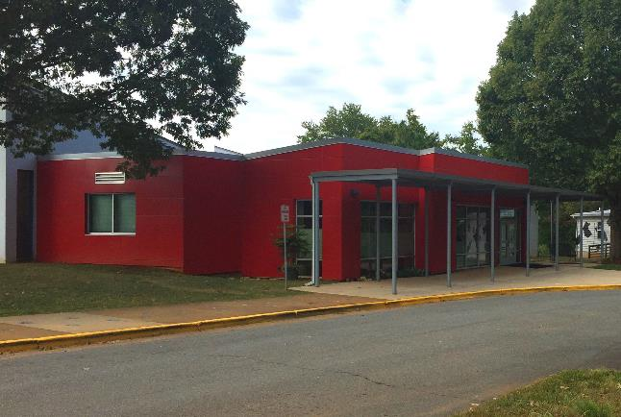
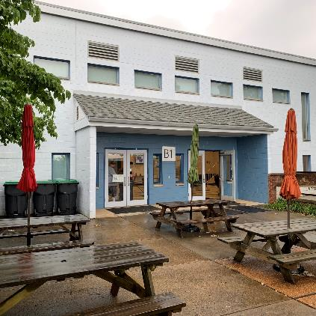
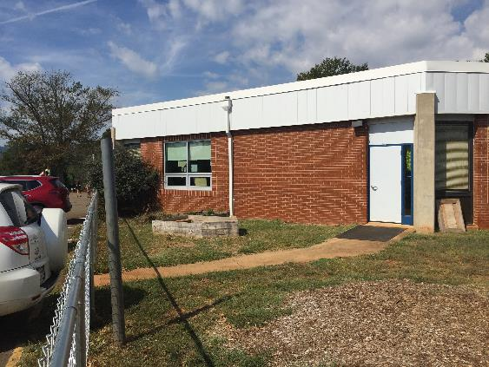
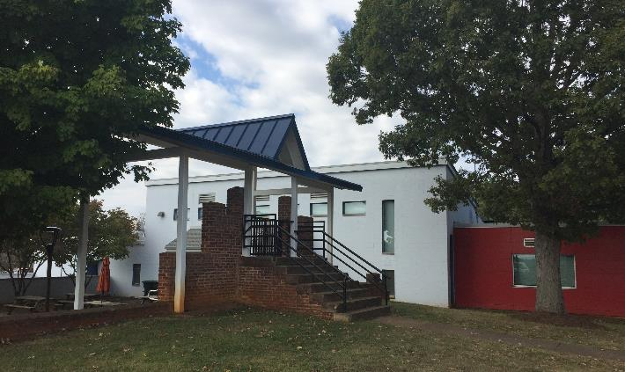
Exterior Character:
Existing Building Materials
Red Metal Panels
Clear Anodized Storefront framing
Painted Concrete Masonry Units
Blue Window frames
Red Brick
White Canopy Structure
Blue Metal Roof
Sloped Shingle Roof

Slide 12
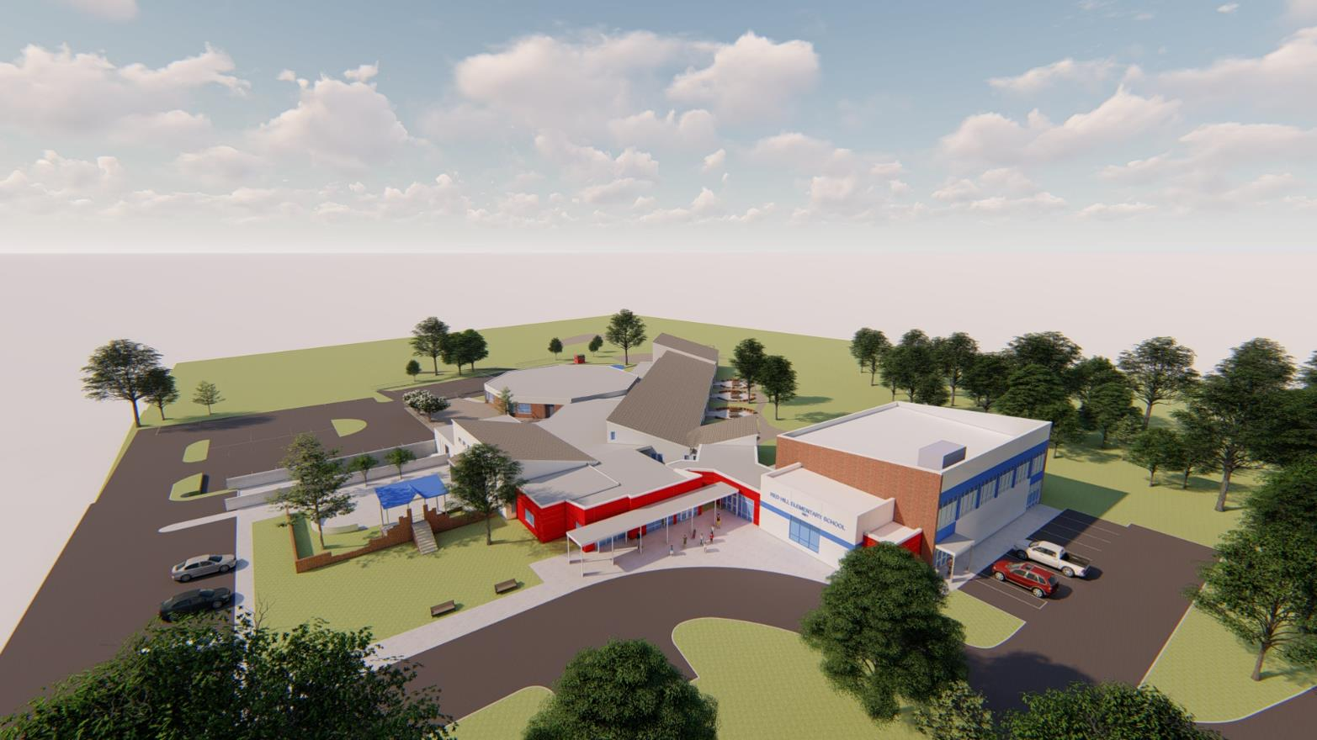
Exterior Character:

Slide 13
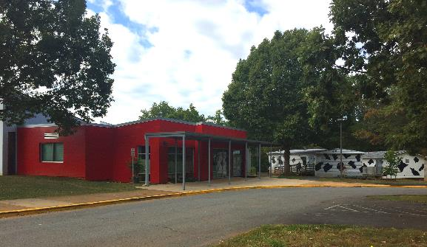

Exterior Character:

Slide 14
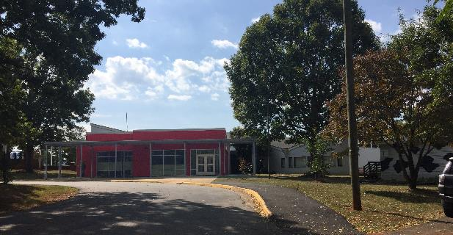
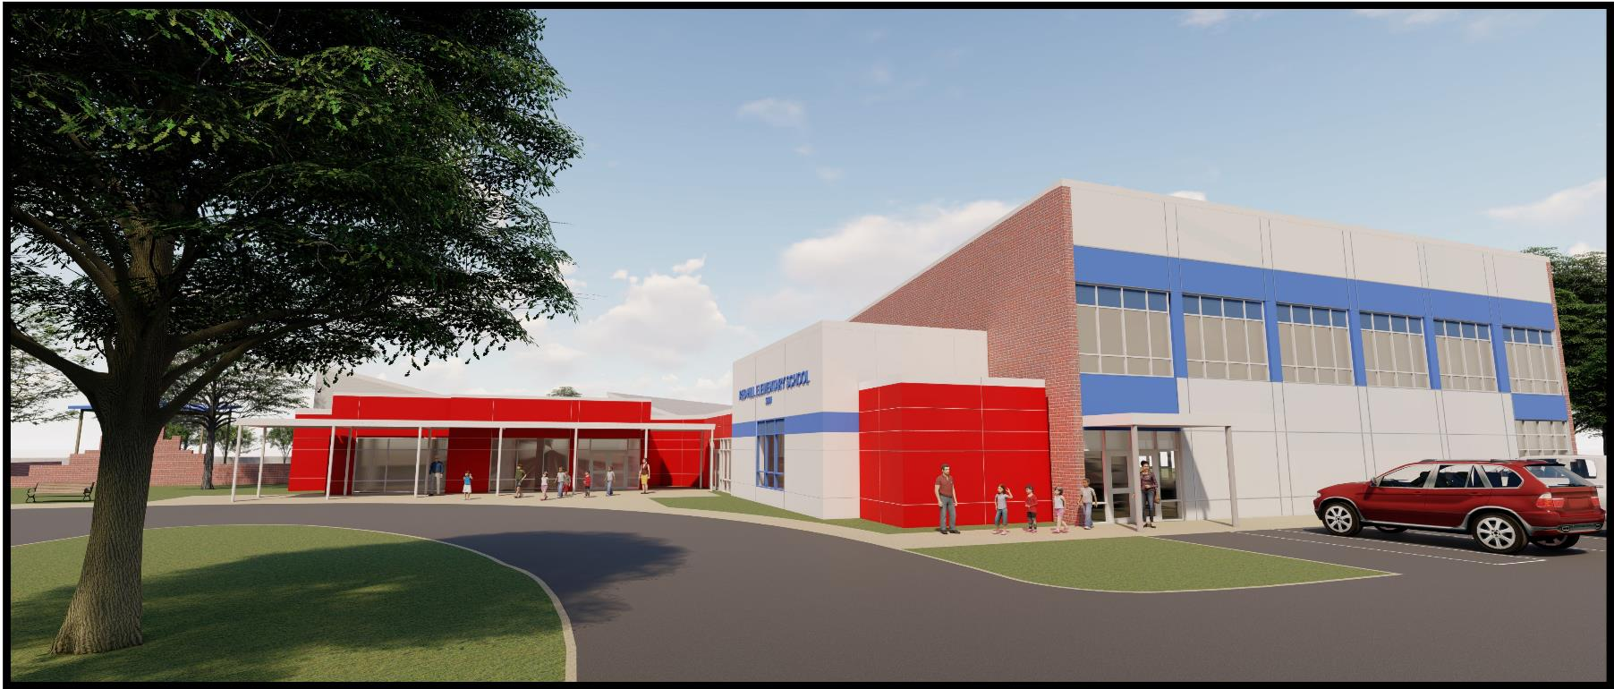
Exterior Character:

Slide 15
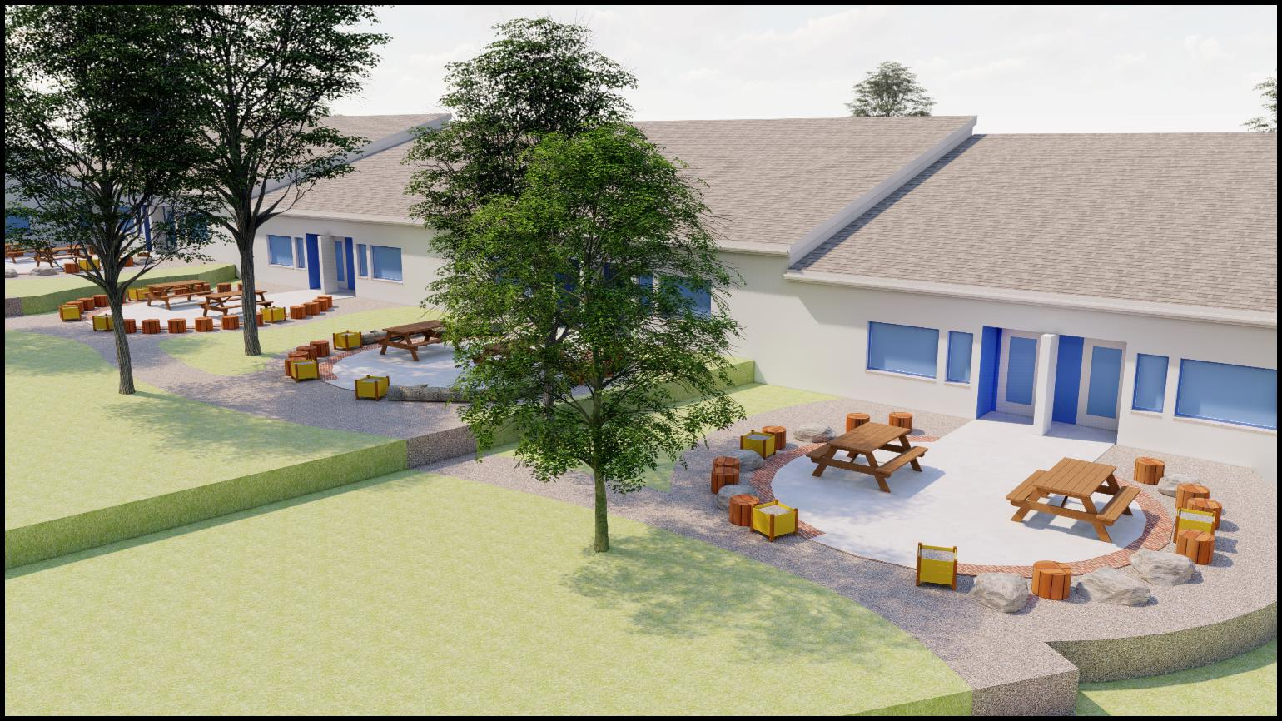
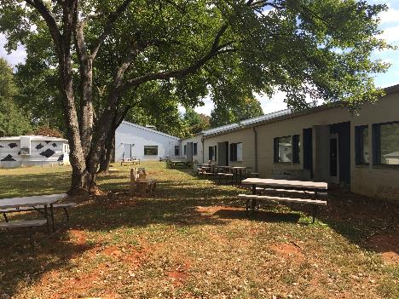
Exterior Character:

Slide 16
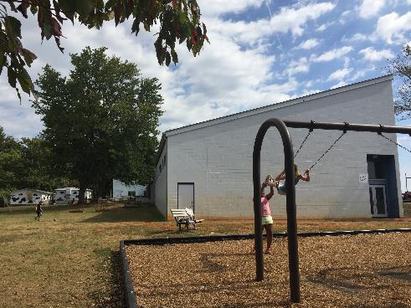
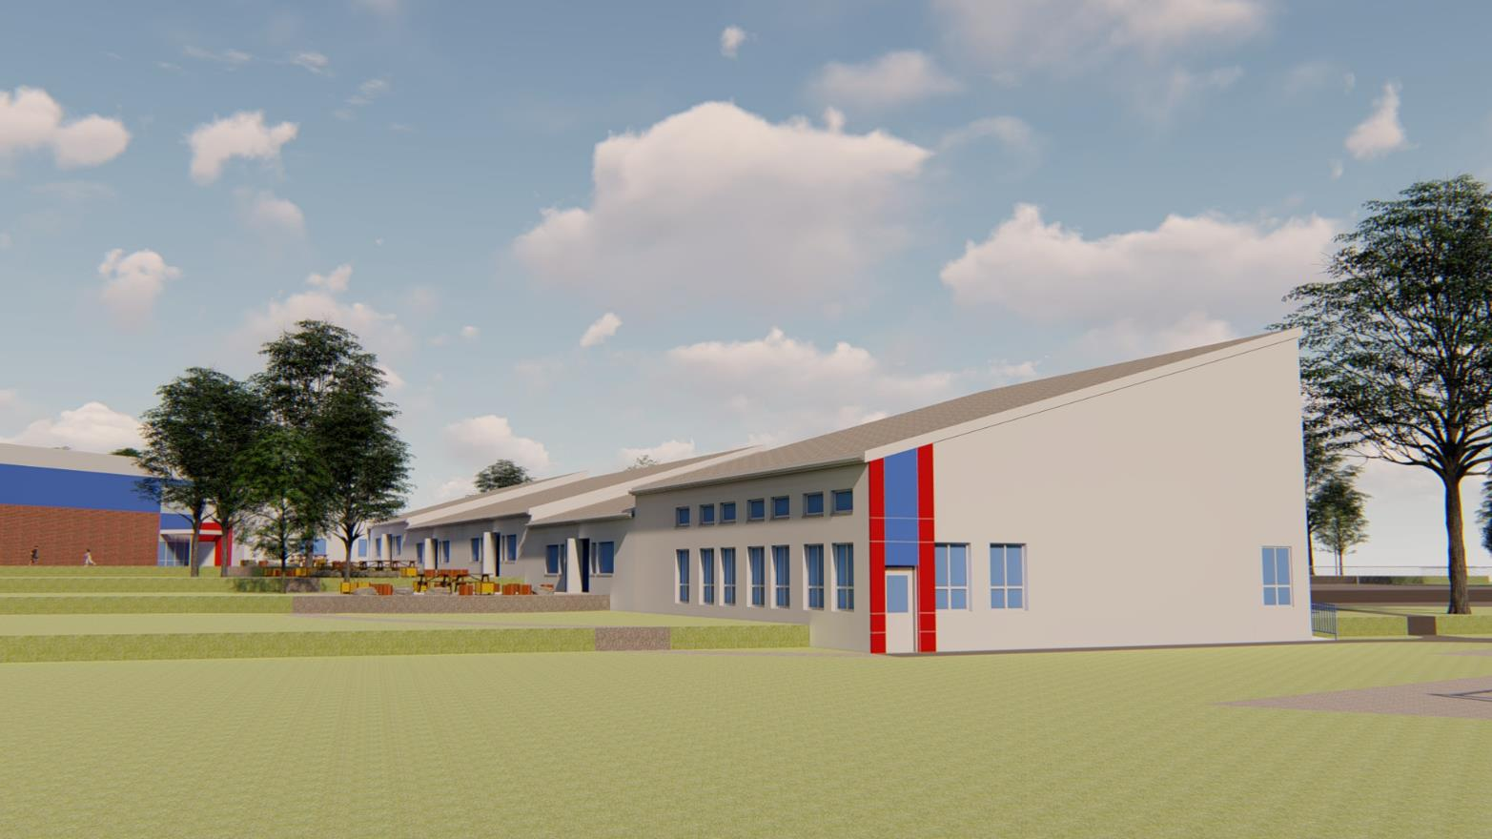
Exterior Character:

Slide 17
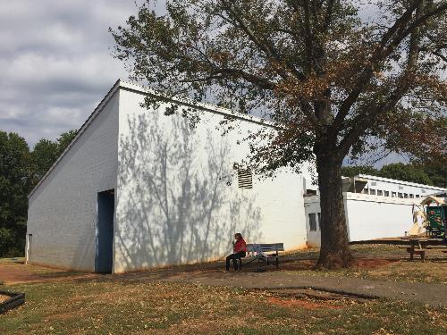
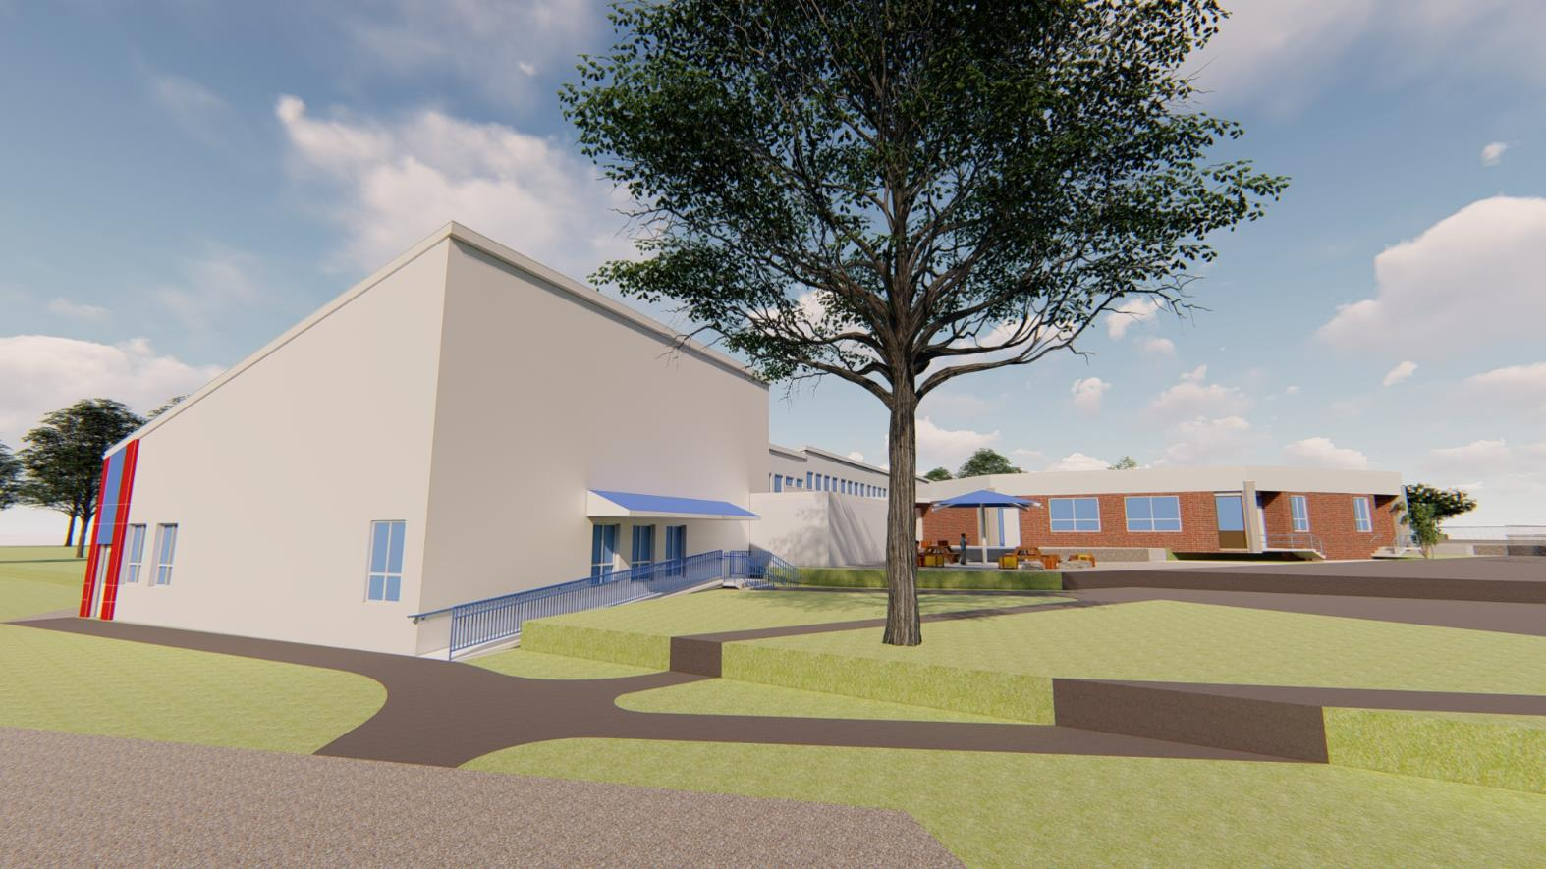
Exterior Character:

Slide 18
Statement of Probable Costs:
Construction Costs
  Addition Cost
  Light Renovation Cost
  Heavy Renovation Cost
  Septic Adjustments
  Hazardous Materials Allowance
  Trailer Relocation / Rental
  Existing Media Center Modifications
  Kitchen Line Serving Improvements
  Outdoor Learning
  Total Construction Costs
  NTE Budget
  Furniture and Equipment Budget
  Technology Budget
Alternates
Alternate No. 1 – HVAC Improvements to Dining
Alternate No. 2 – Stage
$3,938,539
$4,000,000
  $150,000
  $100,000
$100,000
$200,000

Slide 19
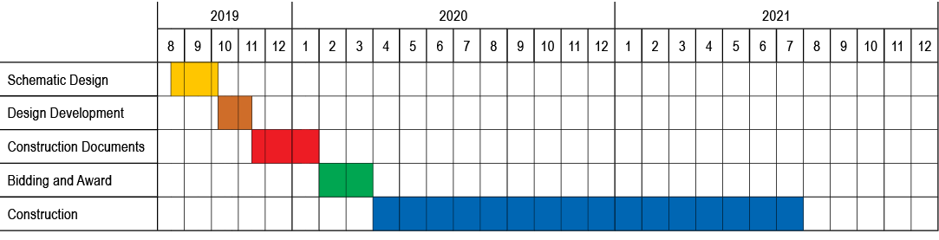
Project Schedule:
Schematic Phase
August 14, 2019 – October 10, 2019
Design Development Phase
October 11, 2019 – November 14, 2019
Construction Documents Phase
November 15, 2019 – January 30, 2020
Bidding and Award Phase
February-March 2020
Construction Phase
April 2020 through August 2021
Project Complete
August 2021

