Slide 1


Five-Year Financial Forecast
FY 20-24
November 5, 2018

Slide 2

Strategic Plan: Horizon 2020
Unleashing Each Student’s Potential
Mission | The core purpose of Albemarle County Public Schools is
to establish a community of learners and learning, through relationships, relevance and rigor, one student at a time.
Vision | All learners believe in their power to embrace learning, to excel, and to own their future.
Core Values | Excellence • Young People • Community • Respect
Student-Centered Goal | All Albemarle County Public Schools students will graduate having actively mastered the lifelong-learning skills they need to succeed as 21st century learners, workers and citizens.

Slide 3
2017-2019 Strategic Priorities
Create a culture of high expectations for all.
Identify and remove practices that perpetuate the achievement gap.
Ensure that students identify and develop
personal interests.

Slide 4
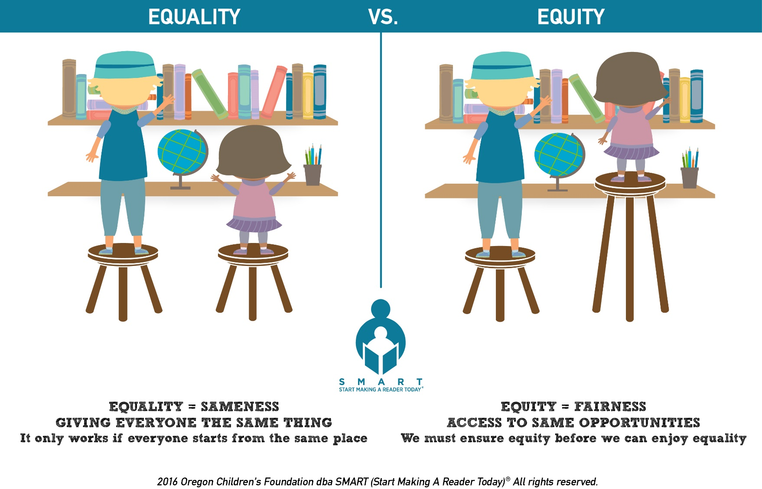
Defining Equity
The shared mission
of our schools is to end the predictive value of race, class, gender, and special capacities on student success by working together with families and communities
to ensure each individual student's success.

Slide 5
Contemporary High School
Changing Emphasis—Not Changing Everything
Traditional Transcript Approach
Profile of a Graduate
Workplace
Skills
Career
Exploration
Content Knowledge
Content
Knowledge
Career Exploration
Workplace Skills
Community Engagement
& Civic Responsibility
Community Engagement
& Civic Responsibility

Slide 6
Per Pupil Revenue Comparison
*Adjusted for inflation (2008 constant dollars)

Slide 7
Preliminary Revenue Considerations
Federal | State | Local
Consistent funding anticipated Remain watchful of possible reductions and program changes | Year 2 Biennial Budget includes adjustment of Local Composite Index (LCI—relative ability to pay) Includes partial state funding for teacher raises | Lower revenue growth than in the prior three years

Slide 8
Primary Drivers of the Plan
Compensation & Benefits – Year 1
  2.3% Market Increase for Teachers
  2.3% Market Increase for Classified Staff + Merit
  Health Insurance: Rates projected to be 2.7% higher than current rates
Enrollment Growth
Changing Demographics
  Economically Disadvantaged
  English Learners
  Special Education
Inflation

Slide 9
Compensation Assumptions
Based on Commonality
% Increase | FY 19-20 | FY 20-21 | FY 21-22 | FY 22-23 | FY 23-24
Salary | 2.3% | 3.0% | 3.0% | 3.0% | 3.0%
Health Insurance | 2.7% | 6.7% | 8.0% | 8.0% | 8.0%
Virginia Retirement System (VRS)* and Group Life Insurance | 0.0% | 0.5% | 0.0% | 0.5% | 0.0%
*The School Division’s VRS percent can vary significantly from Local Government’s rate from year to year

Slide 10
Student Enrollment, K-12
Annual Increase | 253 | 46 | 38 | 166 | 59 | 97 | 44 | 182 | 142 | 97

Slide 11
Economically Disadvantaged Students
Based on September 30th Enrollment, Grades PK-12
FY 09-10 | FY 17-18 | FY 18-19
22.6%
30.4%
29.5%
■ Economically Disadvantaged Students ■ Non-Economically Disadvantaged Students
Notes:
Experienced consistent growth in the number of students who qualify for F/R meals through 2017-18
Experienced our first drop in the number of economically disadvantaged students this year (from 4,229 to 4,124)
Slight dips in the percentage of economically disadvantaged students from 2015-16 to 2016-17 (28.8% to 28.7%) and from 2017-18 to 2018-19 (30.4% to 29.5%)

Slide 12
Special Program Costs Over Time
FY 10-11 to FY 18-19: $15.6 Million Increase (▲62.1%)

Slide 13
Five-Year Financial Forecast (in millions)
Includes common salary, inflation and benefit assumptions, and teacher growth,
but NO initiatives
GAP | ($2.36) | ($5.04) | ($7.591) | ($11.11) | ($14.20)

Slide 14
Funding Considerations
NOT Included in Five-Year Financial Forecast
Additional Teacher Compensation Strategies
Targeted Classified Compensation Strategies (for hard-to-fill positions)
Equity
School Safety
Mental Health
Additional initiatives aligned with our Strategic Priorities

