Slide 1

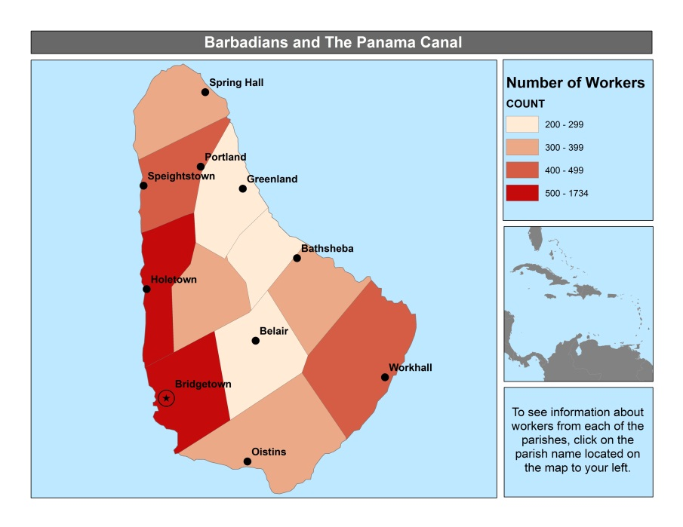
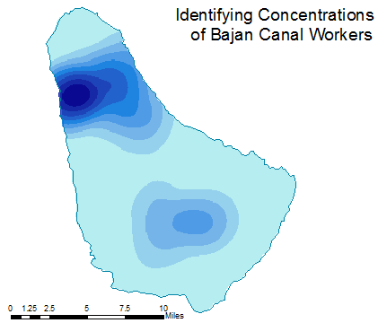
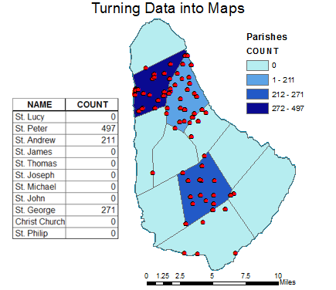
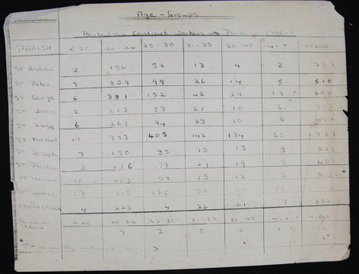

Utilizing ArcGIS to Map Historical Data
The Problem: The National Barbados Museum wanted to map data on the number of Bajans, who went to work on the Panama Canal during the early 1900s. After gathering data across the island, they came to us asking if it would be possible to transfer the data into map form that can be used in a upcoming exhibit.
The Process: First, locations of the workers had to be translated into coordinate points and then we transferred them into a drawn map of Barbados. Then a kernel density map was made to show the densities of the workers across the island.
The Results: We can conclude which parishes supplied the most workers to the Panama Canal and overall, which parts of the island had the highest density of workers.
The Value: By mapping the data for this project, it can be concluded that historical data can be mapped relatively easily as long as you have a large portion of time set aside. Furthermore, this case study shows that libraries, museums, etc. can even map their own data to give a valuable visual. Most importantly, this shows Barbados’ Panama Canal data in a new way that is easier to understand.
Original Panama Canal Data
Created by Ashley D.

Slide 2
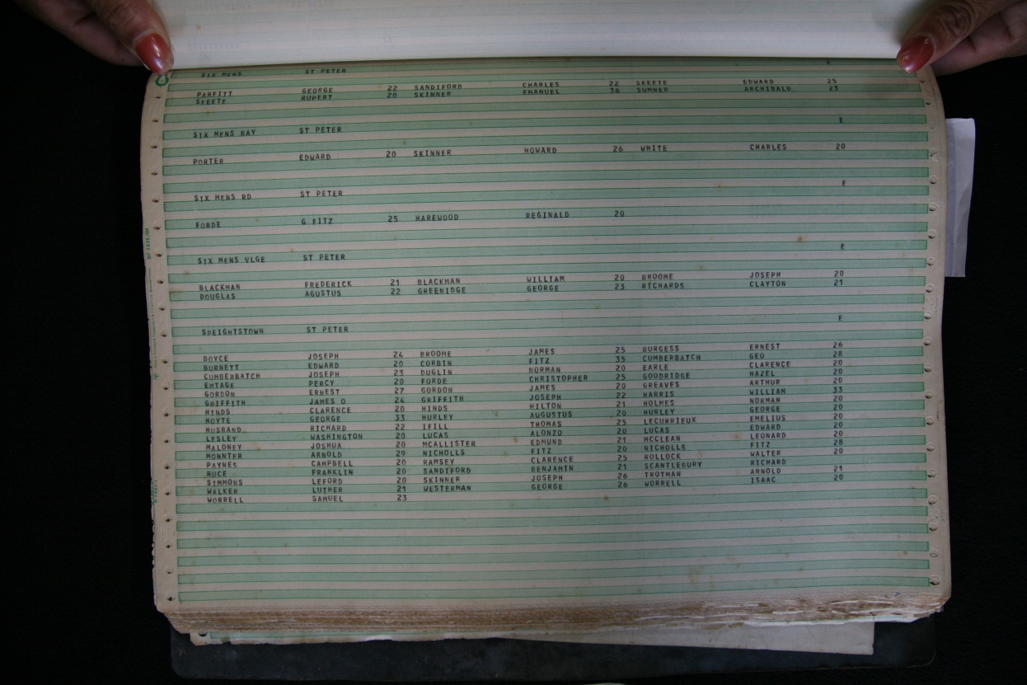
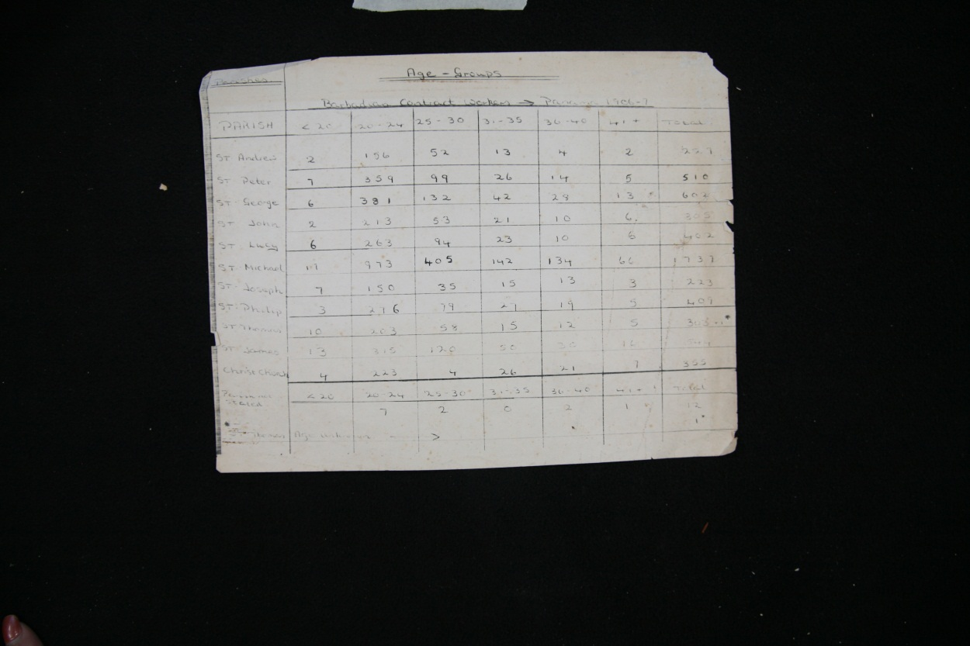
TRANSLATING TRADITIONAL ARCHIVES IN THE DIGITAL ARCHIVES
AGE | PARISH | LOCATION | Image # |  | LAT | LON
22 | ST. GEORGE | HOLBORN | 141
22 | ST. GEORGE | HOPE | 141 |  | 13.1365 | -59.546
20 | ST. GEORGE | HOPE | 141 |  | 13.1365 | -59.546
22 | ST. GEORGE | HOPE | 141 |  | 13.1365 | -59.546
20 | ST. GEORGE | HOPE | 141 |  | 13.1365 | -59.546
36 | ST. GEORGE | HOPE | 141 |  | 13.1365 | -59.546
29 | ST. GEORGE | HOPE | 141 |  | 13.1365 | -59.546
25 | ST. GEORGE | HOPE | 141 |  | 13.1365 | -59.546
39 | ST. GEORGE | HOPE | 141 |  | 13.1365 | -59.546
20 | ST. GEORGE | HOPE | 141 |  | 13.1365 | -59.546
29 | ST. GEORGE | HOWARDS LAND | 141
37 | ST. GEORGE | JACKMAN VLGE | 141
20 | ST. GEORGE | JACKSON | 141
25 | ST. GEORGE | JERICHO | 141 |  | 13.15 | -59.55
28 | ST. GEORGE | JERICHO | 141 |  | 13.15 | -59.55
31 | ST. GEORGE | JORDAN | 142 |  | 13.1334 | -59.55
23 | ST. GEORGE | JORDAN TNTRY | 142 |  | 13.1334 | -59.55
20 | ST. GEORGE | JORDANS | 142 |  | 13.1334 | -59.55

Slide 3
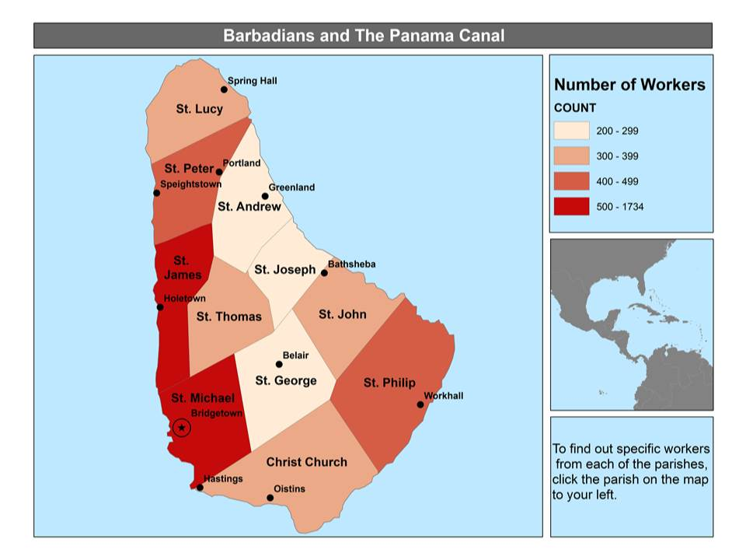
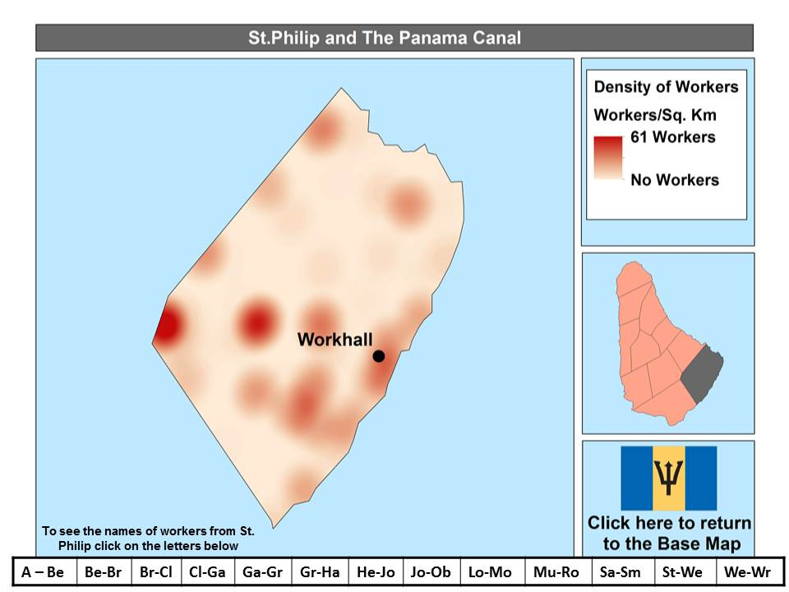
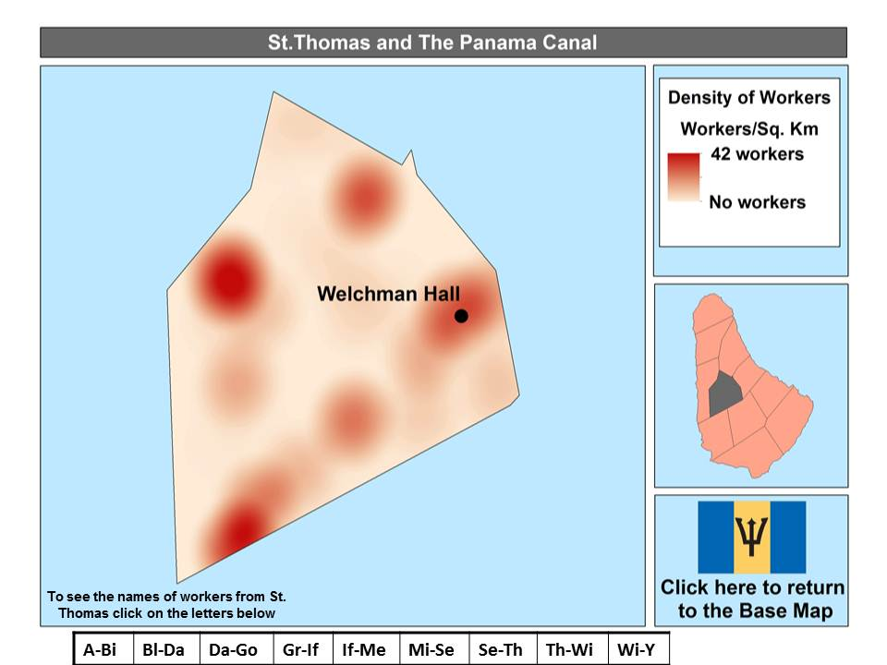
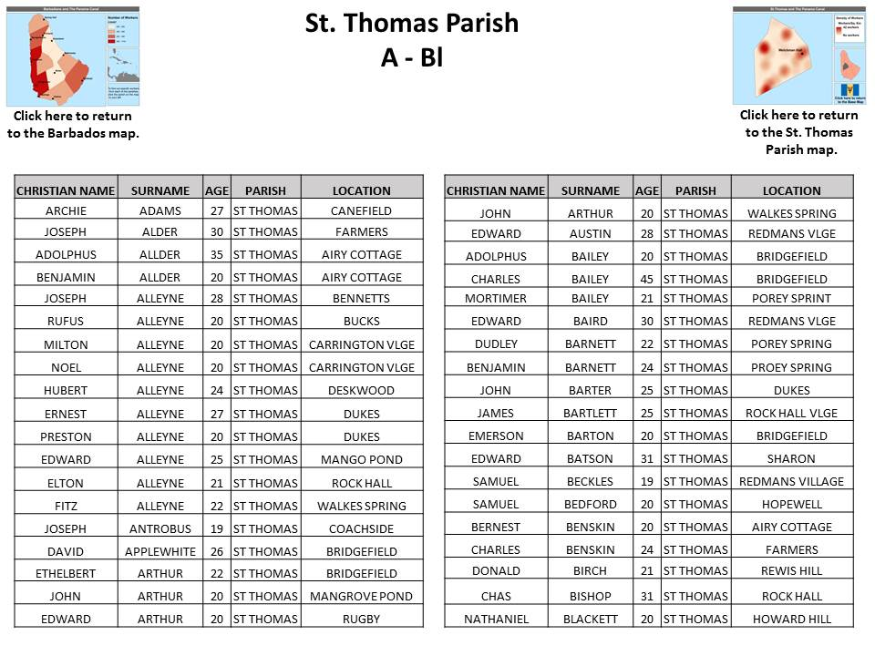

Slide 4
