Slide 1
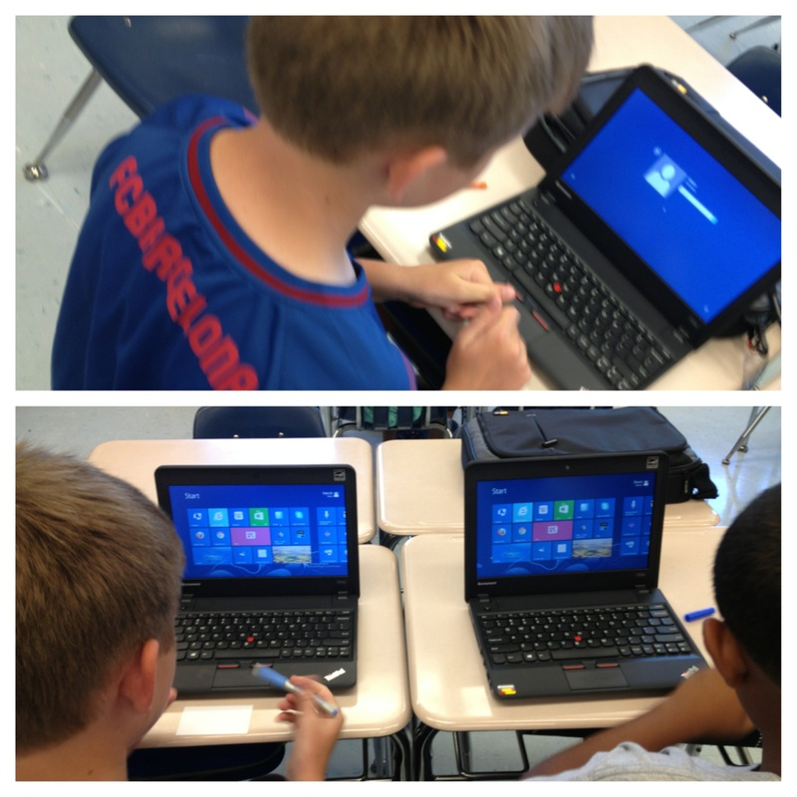
DART UPDATE
Instructional pilots and infrastructure update

Slide 2
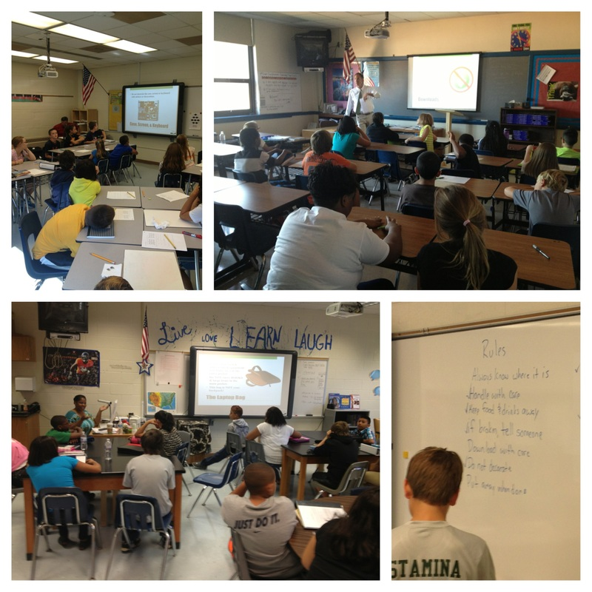
Digital Learning Pilots
Burley Middle School
  6th Grade Students
Jouett Middle School
  7th grade students
Walton middle School
  6th through 8th
Monticello High School
  9th Grade

Slide 3
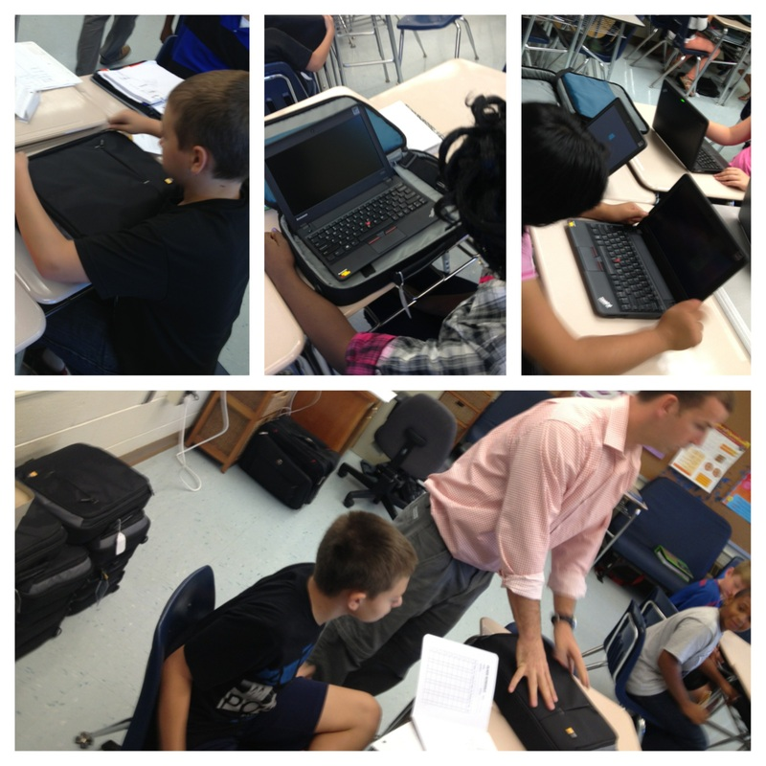
Instructional Goals
Monticello HS, Burley MS, and Walton MS
  Digital writing
Jouett MS
  Digitization of AVID and digital citizenship

Slide 4
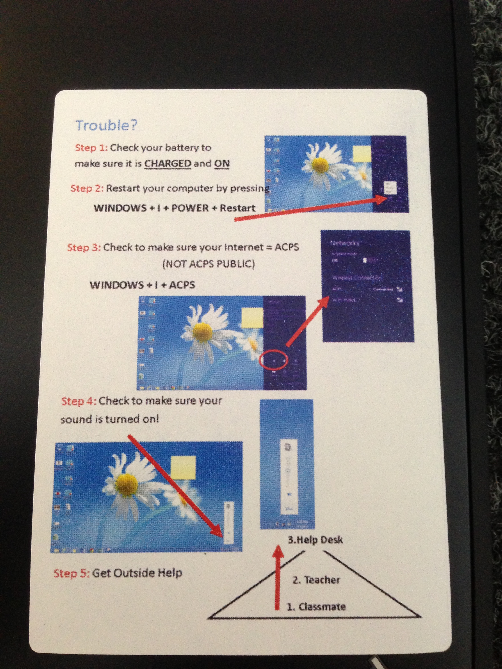
Planning for 2014-2015
Each site was required to have the following:
  Parent Meeting held prior to the devices being issued
  Internet safety training and technical training for students
  Student Run HelpDesk for technology related issues

Slide 5
Infrastructure Updates
Fiber Optic construction
  Construction is currently underway
  Project will take roughly 2-3 years to fully complete
  11 of 30 sites connected via fiber
  Working on backbone for the remainder of the school year.
Wireless wide area network
  Continue to work to develop public to public and public to private partnerships
  New developments in technologies will allow for greater speeds than anticipated.

Slide 6
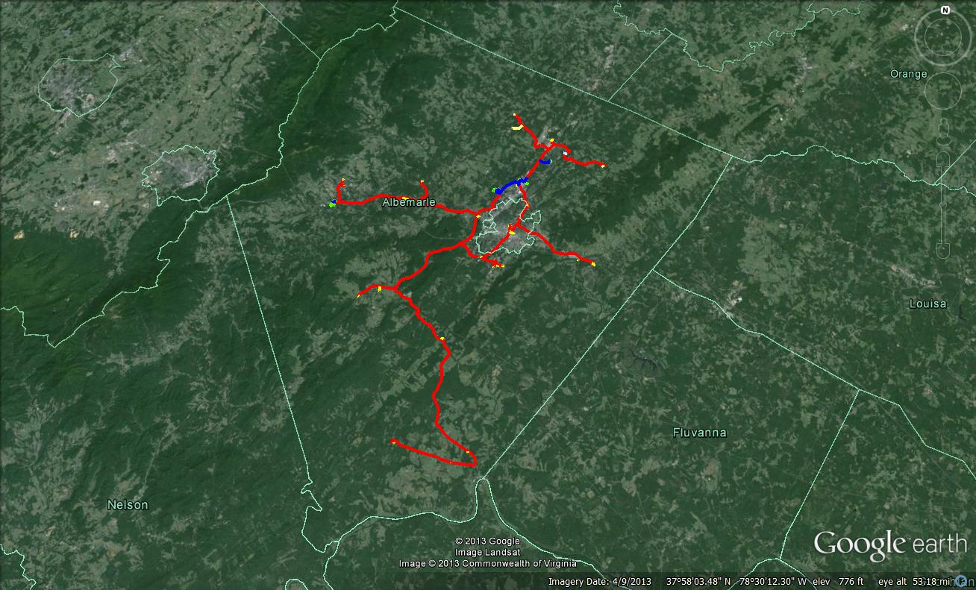

Slide 7
