Slide 1
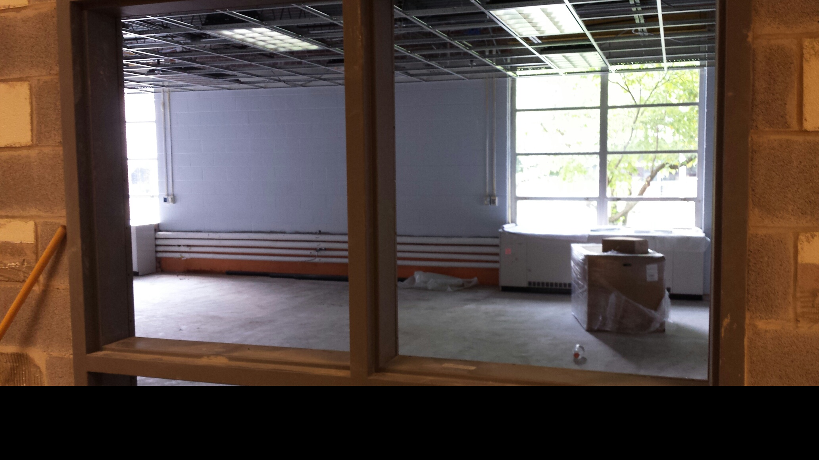
Design 2015 Progress
Woodbrook Elementary
New Art Room/Maker Space

Slide 2
Construction
Woodbrook - New Art Room/Maker Space
including outdoor art area
Albemarle High School - New “X-cubed” writing and collaborative creation space
Henley – 2 new math/collaborative flexible work spaces.
Meriwether Lewis – New student collaboration room, new Maker Zone in Library

Slide 3
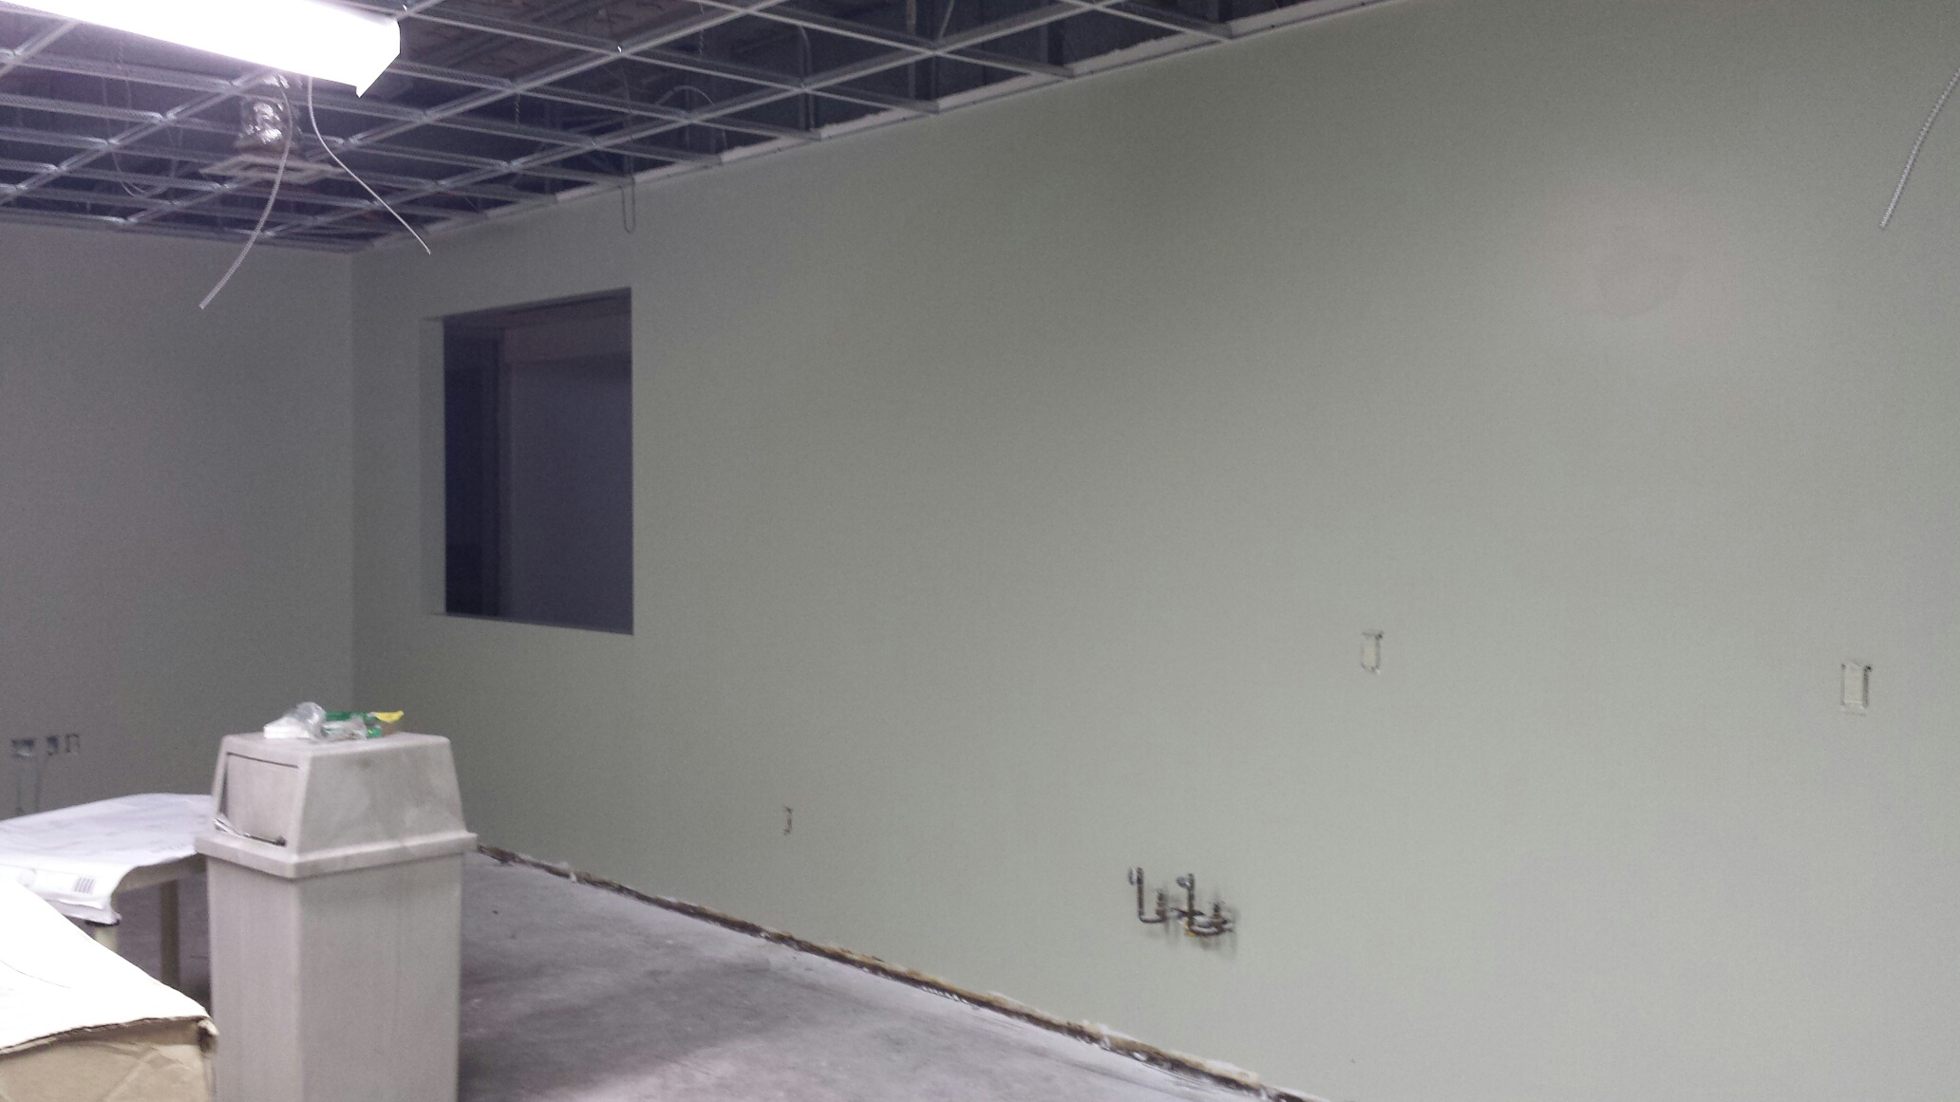
Albemarle High School
Was VHS storeroom:
Soon “X-cubed” collaboration zone

Slide 4
Construction
Hollymead – Redesigned Library and new collaboration/maker courtyard (with art room access)
Murray Elementary – Cafeteria becoming indoor/outdoor “Commons” – multipurpose
Walton – “Walton Commons” reconfigured collaboration space
Monticello High School – New HackerSpace and MakerSpace at Library

Slide 5
Maker-Infused
Hands-on Problem Solving
Middle Schools – New Arduino/Raspberry Pi Digital Maker Curriculum for CTE
Small Elementary’s – Maker Summer Schools
Maker-Infused Curriculum for Fall
High Schools – Challenges for Math Support
New Maker Spaces at Baker-Butler, Scottsville, Yancey, Red Hill, Stony Point

Slide 6
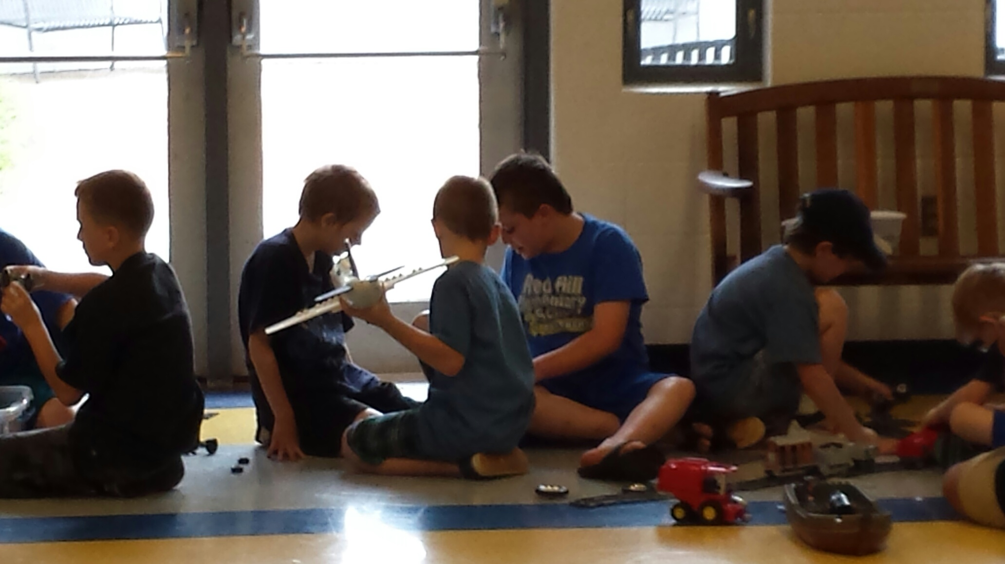
Red Hill Elementary
“in a suspension bridge you have to keep
the cables taut” – summer school 3rd grader

Slide 7
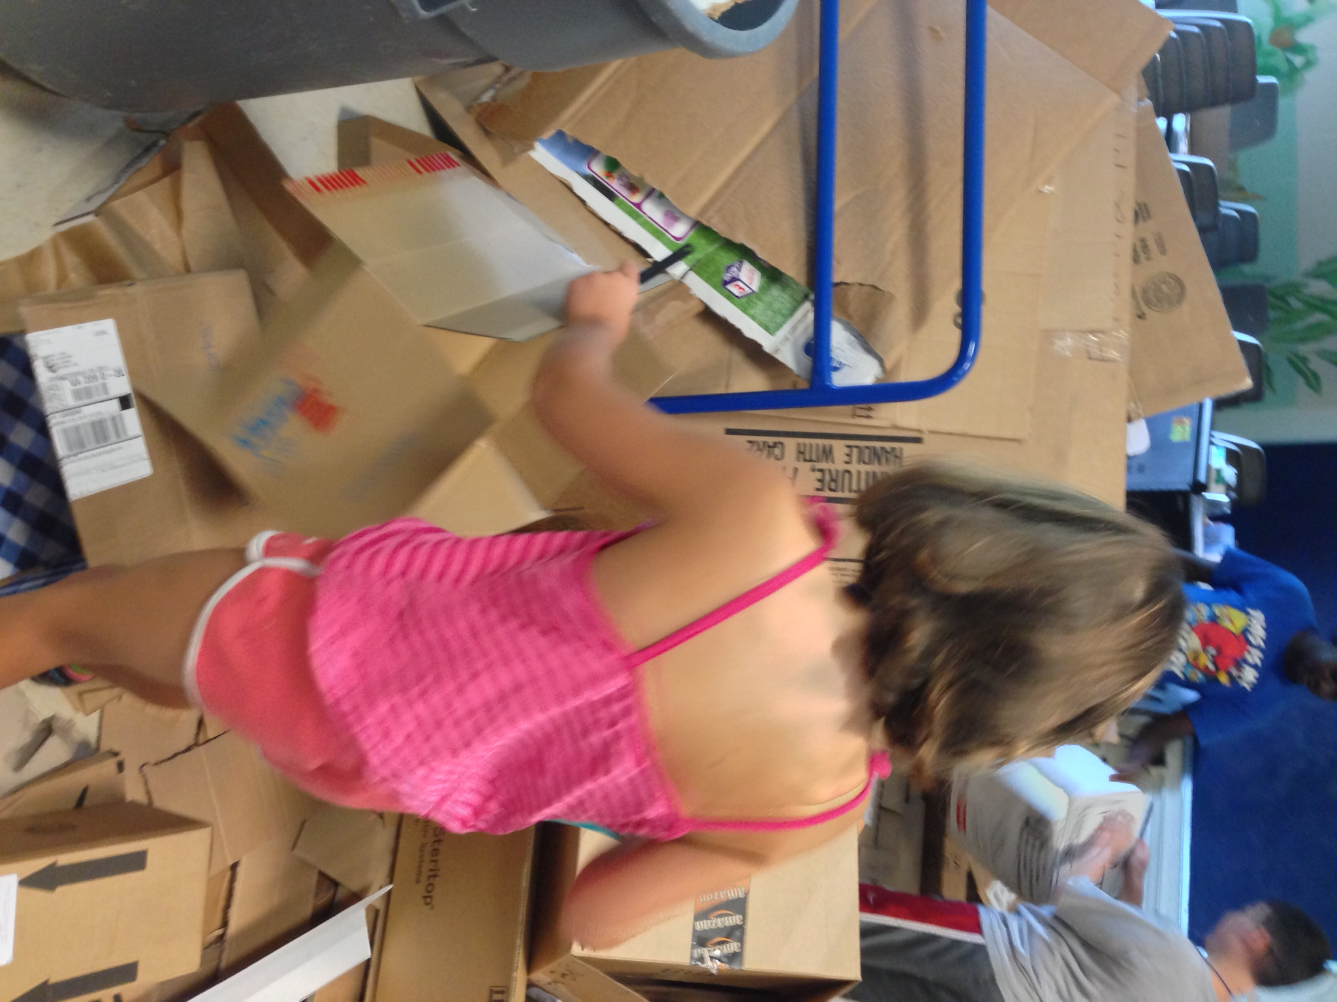
Stony Point Maker Space

Slide 8
Technology
1:1 Windows 8 at Monticello (9th), Burley (6th), and Jouett (7th). Upgraded 1:1 at Walton
Android device-driven World Languages at Albemarle High School
“Tool Cribs” for task-based technology choice at many elementaries
Notes:
Over 1,600 new devices from Design 2015, another 2,000+ from DART for schools

