Slide 1
Department of Accountability, Research, and Technology
Budget Presentation
Always on target

Slide 2

Service Alignment
Accountability
Bonnie Pendleton
Enterprise Application
Mark Leach
Infrastructure and Support
Robert Rejonis
Client Service
Tiffany Mills
Educational Technology
Becky Fisher
Notes:
Explain these groups

Slide 3
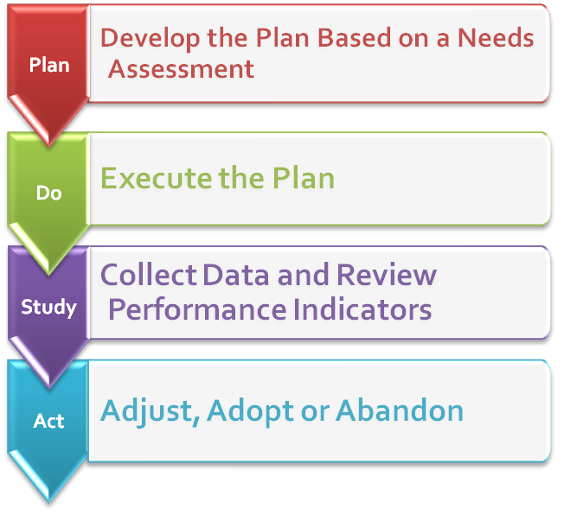

Plan
Do
Study
Act

Slide 4
Budget Efficiencies for 2012-2013.
Fund 2115 – Technology
SchoolNet ($30,000/YR)
School Center ($26,000/YR)
Travel Reductions ($10,000/YR)
  Remote Services
Fund 2118 – Accountability & Administrative
SmartNet ($30,000)
Local Phone Services ($2400/YR)
WebEx migration to Blackboard Collaborate ($25,000/YR)
Fund 3907 – Hardware & Systems Replacement
Hardware Acquisitions ($200,000/YR)
Switches/Access Point Procurement ($500,000 one-time)

Slide 5
Initiatives for 2013-2014
Increase buildings based technical support due to growth (3 FTE)
  $201,000
Increase cost of cellular services
  $60,000
Roll-out and deploy a new student registration system
  $30,000

Slide 6
Increase technical staffing due to growth in staff, students, and devices
(3 FTE)

Slide 7
Current Staffing
School Support
Client Service Specialists | 12
Service Desk Engineers | 3
Network Engineers | 4
Total | 19

Slide 8
Instructional Technology Devices
Devices included are:
Laptops, Desktops, Whiteboards, iPads, iPods, Carts, Tablets, PDAs, Printers, Projectors, Smart Tables, Thin Clients, Touch Screens.

Slide 11
Increase in cost of cellular devices

Slide 12
Cost of Mobility
Number of devices have increased over the past 3 years
Type of access has increased
  Cellular Service $25/month
  Cell/Data Service $50/month

Slide 13
New Online Students Registration System

Slide 14
Online Registration for New Students
Increase customer service to all parents
Reduce the time OA staff spend entering student data.
Increase the efficiency of entering student data.
Cost saving for printed registration packets
Increase student data available to other systems.
  Powerschool
  Versatrans
  Estimated cost saving of $80,000 annually in staff time and resources

Slide 15
Operational Funds

Slide 16
Budget 2115 and 3907 – Computer Technology
Notes:
Voice Video and Data – 400,000
Smartnet – 100,000
Microsoft – 70,000
Antivirus 50,000
Content Filter – 35,000
Kaseysa – 25,000
3907 – All repairs and maintaince – 200,000
Printers
Projectors
Smartboards
Systems maintance

Slide 17
Student and Teacher Computers

Slide 18
Fund 2118 Assessment & Information Services
Notes:
430,000 is contractually obligated
Schoolnet
Powereschool
Assessments
Alexandra
BB connect
Walkthrough

Slide 19
Questions
Thank You

